Slide 1
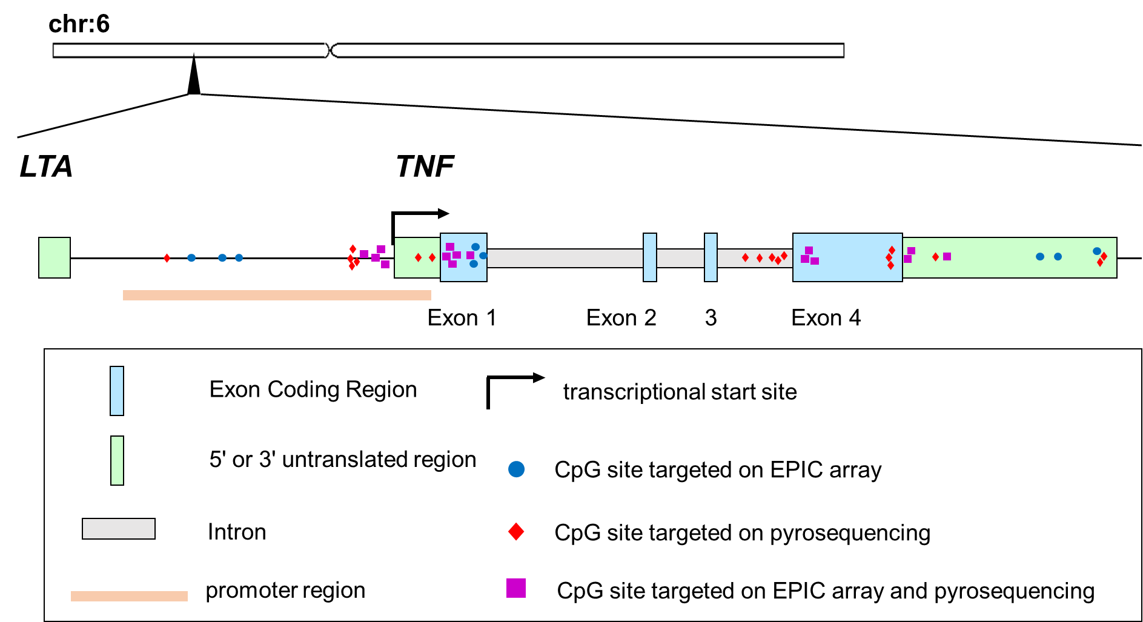

DNA methylation in the TNF-alpha gene decreases along with aging among delirium inpatients
Takehiko Yamanashi MD, PhD ^{1, 2}, Gen Shinozaki MD ^{1, 2}
1. Stanford University, 2. University of Iowa
Background
Results
Table 2 Correlation of age and DNAm at 33 CpGs measured by pyrosequencing
It has been suggested that aging and inflammation play key roles in the development of delirium. We previously reported significant age-associated decreases of DNA methylation (DNAm) in the TNF-alpha in blood and in glia [1].
Table 1 Correlation of age and DNAm at 24 CpGs
measured by EPIC array
Objective
In the present study, we investigated the differences of the DNAm patterns in the TNF-alpha between patients with delirium and without delirium using two different methods, genome-wide EPIC array and pyrosequencing method. This is the first study investigating DNAm difference in TNF gene associated with delirium.
Methods
The data and samples derived from previous [2, 3] and ongoing cohort studies were analyzed. DNAm levels at 24 CpGs in the TNF-alpha gene of 87 blood samples (delirium: N=44, non-delirium: N=43) were analyzed using the Illumina EPIC array genome-wide platform. DNAm levels at 33 CpGs in the TNF-alpha gene of 143 blood samples (delirium: N=58, control: N=85), 86 buccal samples (delirium: N=36, non-delirium: N=50), and 58 peripheral blood mononuclear cells (PBMC) samples (delirium: N=26, control: N=32) were analyzed using the pyrosequencing method. Correlations between age and DNAm levels of each CpGs were calculated.
Schematic diagram of TNF gene and targeted CpG sites.
*Significant after correction for multiple testing level (p < 0.05/24 = 0.0021)
[4] Yamanashi T, et al. Neurobiol Aging in press
Conclusion
*Significant after correction for multiple testing level (p < 0.05/33 = 0.0016)
presentation
The relationship between age and decreased TNF gene DNAm in the blood were demonstrated using two different methods. Furthermore, it the negative correlations were more robust in PBMCs than in blood. These findings provide further evidence of the potential role of epigenetics and inflammation in delirium pathophysiology.
References
1. Shinozaki G, et al. Front Aging Neurosci. 2018
2. Saito T, et al. Neurobiol Aging 2020
3. Saito T, et al. J Psychiatr Res. 2020
4. Yamanashi T, et al. Neurobiol Aging in press

